Slide 1

Bitcoin Price Predictor Using Machine Learning Guided by: Aishwarya Saxena (Mentor)
e
Winter Internship – January-February(2021)
Project
Completed By:
Pankaj Kumar
Sayyed Lubna Rahmat
Ananya Sen
Adil Ahmed

Slide 2
INDEX
S. NO. | TOPIC | SLIDE NO.
1. | INTRODUCTION | 3
2. | OBJECTIVE | 4
3. | BACKGROUND | 5
4. | HARDWARE AND SOFTWARE REQUIREMENTS | 6
5. | FUTURE SCOPE | 7
6. | RESULT | 8
7. | CONCLUSION | 9
8. | REFERENCES AND BIBLIOGRAPHY | 10

Slide 3

INTRODUCTION
Bitcoin is a global cryptocurrency and online payment system that is highly stable and secure. It is Peer-to-peer value transfer and transaction protocol.
There are some algorithms used on stock market data for price prediction but the parameters affecting Bitcoin are distinctive.
Therefore, it is essential to expect the price of Bitcoin in order that correct investment decisions can be made.
The price of Bitcoin does now not rely on at the business events or intervening government in contrast to the stock market.
Hence, to expect the value we feel it is essential to leverage machine learning technology to expect the rate of Bitcoin.

Slide 4
OBJECTIVE
The prime objectives of this project are:
To predict bitcoin price with maximum efficiency.
To ensure less risk and more profit for investors.
To compare between machine learning models to find which one is the best efficient algorithm for predicting bitcoin price.
Helpful for the customers to decide their investment plans in bitcoins.
To make correct investment decisions.

Slide 5
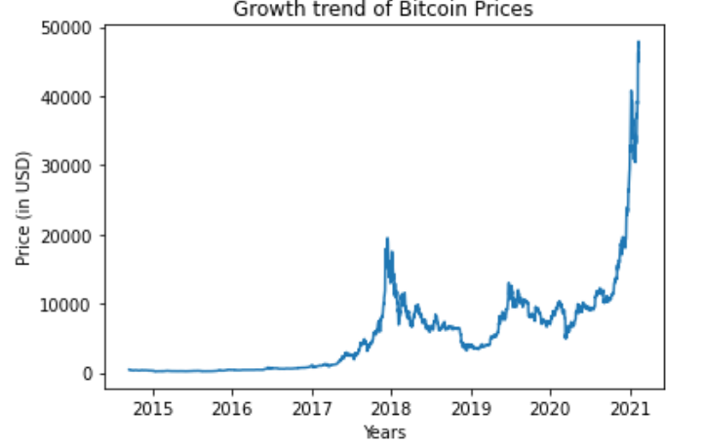

BACKGROUND
In this project we have used the Support Vector Regression function which is a type of Support Vector Machine. A Support Vector Regression (SVR) is a type of supervised learning algorithm that analyses data for regression analysis.
We have also used the Linear Regression model to predict the Bitcoin prices. Linear regression attempts to model the relationship between two variables by fitting a linear equation to observed data. One variable is considered to be an explanatory variable, and the other is considered to be a dependent variable.
Finally, we have compared the result of both the models.

Slide 6
HARDWARE AND SOFTWARE REQUIREMENTS
Hardware Used
Software Used
Hardware | Used
RAM | 8GB
Processor | Intel i5 650
GPU | Nvidia GeForce RTX™ 3080
Software | Used
Operating System | Windows 10
Editor | Jupyter Notebook, Pycharm, VS Code
Programming Language | Python
Packages and Libraries | Numpy, Scikit learn, Matplotlib etc.

Slide 7
FUTURE SCOPE
Demand for cryptocurrencies like Bitcoin will definitely increase in near future so such projects will be a great help in predicting the Bitcoin prices.
Market trading will increase using Bitcoin globally, so this project will be a boost in fulfilling the needs of the traders and customers.
This project will be helpful in maintaining balance of competition between the other cryptocurrencies prevailing in the market.
Encourage in developing better model with the predictive power to beat the market.

Slide 8
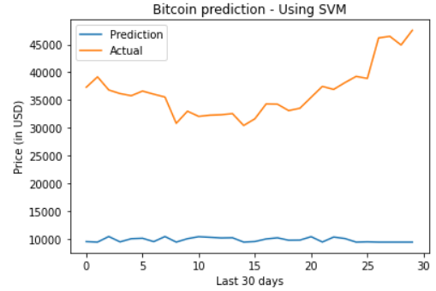
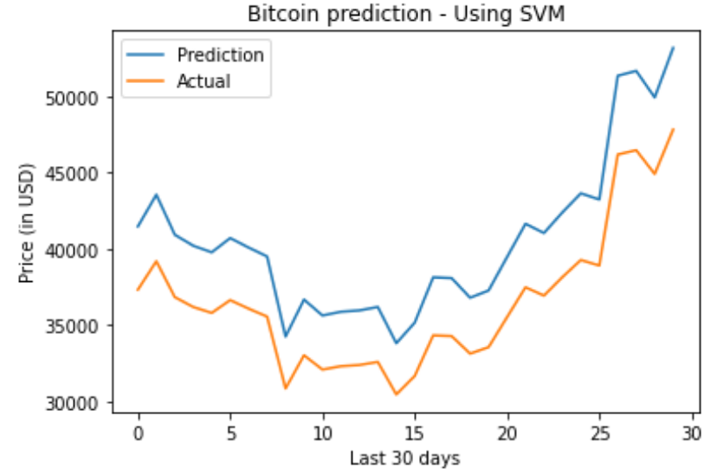
RESULT
Model | Accuracy
SVM | 63.58%
Linear Regression | 88.43%
:
Comparison plot for SVM model
Comparison plot for Linear Regression model
So, we can clearly see that in the SVM model the accuracy score is 63.58%
and for Linear Regression Model it is 88.43%. Also we can see the comparison
plots for the two models, the prediction line and the actual line in case of
SVM are very far away from each other while in case of Linear Regression
the tow two lines are more close to each other.

Slide 9
CONCLUSION
So, we can derive the conclusion that: The linear regression algorithm is more efficient and more accurate than the SVM model in predicting the Bitcoin prices. The machine learning algorithms will improves that feature idea of crypto currencies. That will improves the market price of globule investments.

Slide 10
REFERENCES AND BIBLIOGRAPHY
Data set: Yahoo Finance
Data visualization: Matplotlib (https://matplotlib.org/tutorials/index.html)
Exploratory data analysis: Numpy (https://numpy.org/doc/stable/user/tutorials_index.html), Pandas, Matplotlib(https://matplotlib.org/tutorials/index.html)
Exploratory data analysis: Numpy (https://numpy.org/doc/stable/user/tutorials_index.html), Pandas, Matplotlib(https://matplotlib.org/tutorials/index.html)
Mastering Python for Data Science, Sameer Madhavan 2nd Edition.
Hands-On Machine Learning with Scikit-Learn & TensorFlow (Concepts, Tools and Techniques to Build Intelligent Systems), Aurélien Geron
Scikit-Learn (https://scikit-learn.org/stable/modules/svm.html)
Learning scikit-learn: Machine Learning in Python, By Raúl Garreta, and Guillermo Moncecchi.

Slide 11
Thank You!

